Slide 1

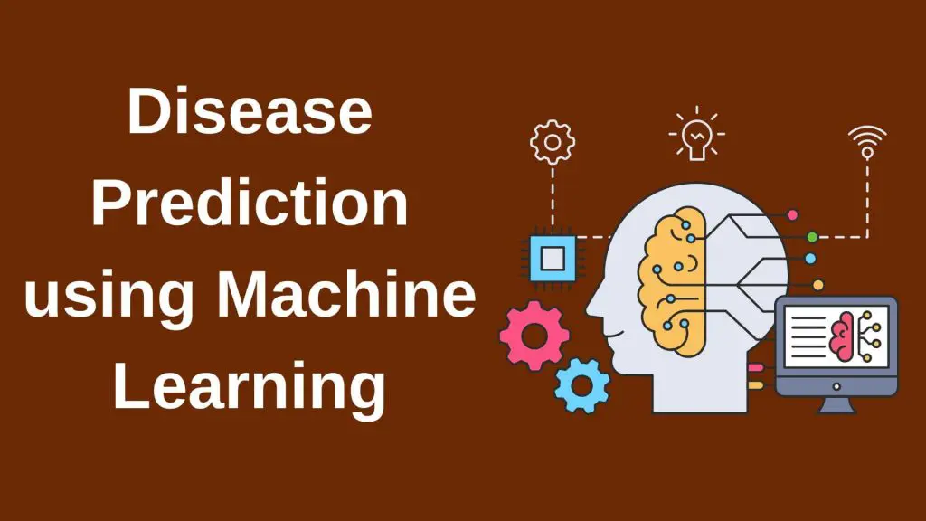

Slide 2

Presented By
Ramkrishna Patra
Md Sahil Zafar
Md Hasnain
Supervised By
Moumita Ghosh
Dept of Information Technology
Haldia Institute Of Technology

Slide 3



Technology Is Evolving Every Day
Today almost
Every Facility is
In our Fingertip
So why Not In
Medical !!!

Slide 4

With Machine Learning We Can Predict The Possibility of a Disease Sitting In Our Home

Slide 5

By Taking Some Input From the User We can Predict Whether they have Heart Disease or Not !!!

Slide 6
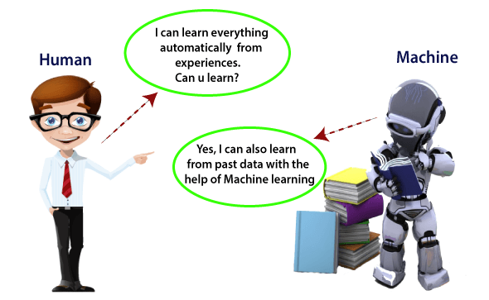
What Is Machine Learning
Machine learning is a field of artificial intelligence that allows systems to learn and improve from experience without being explicitly programmed

Slide 7
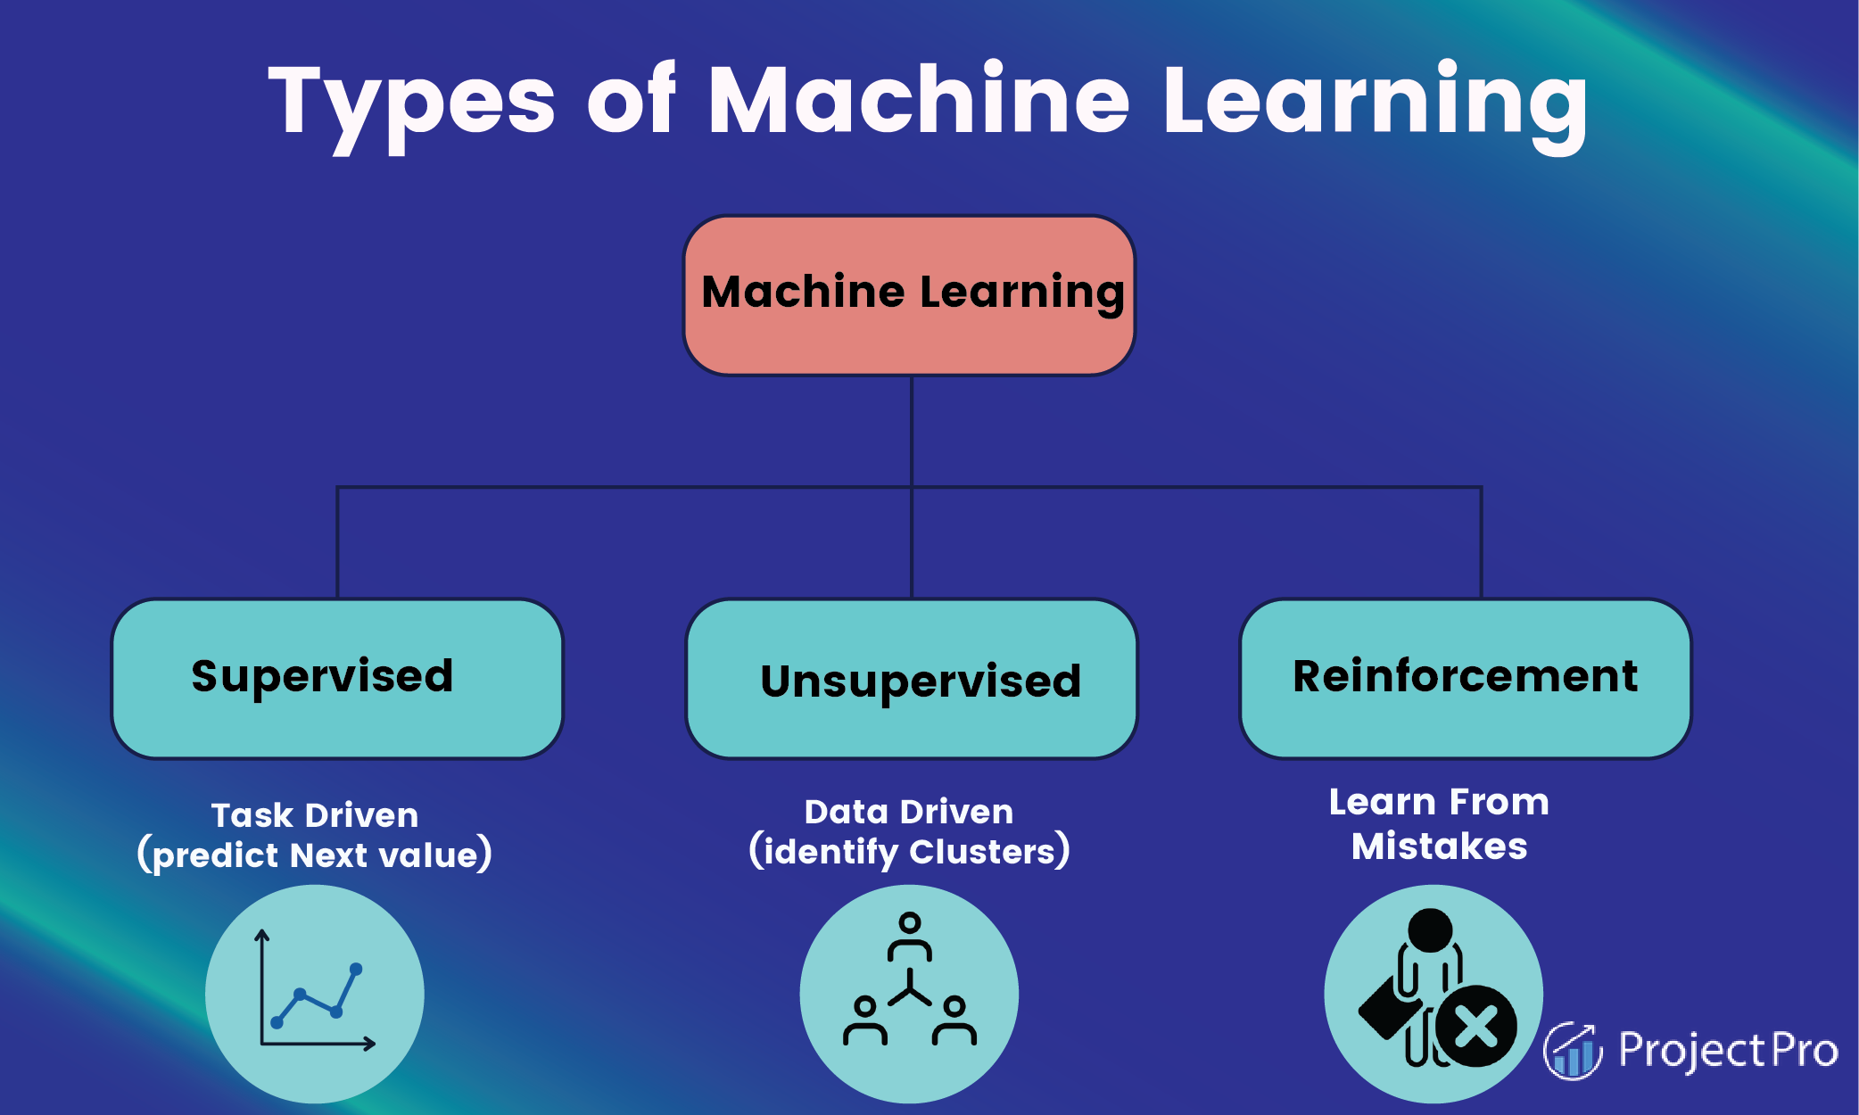

Slide 8
Let’s Explore the ML Algorithms

Slide 9

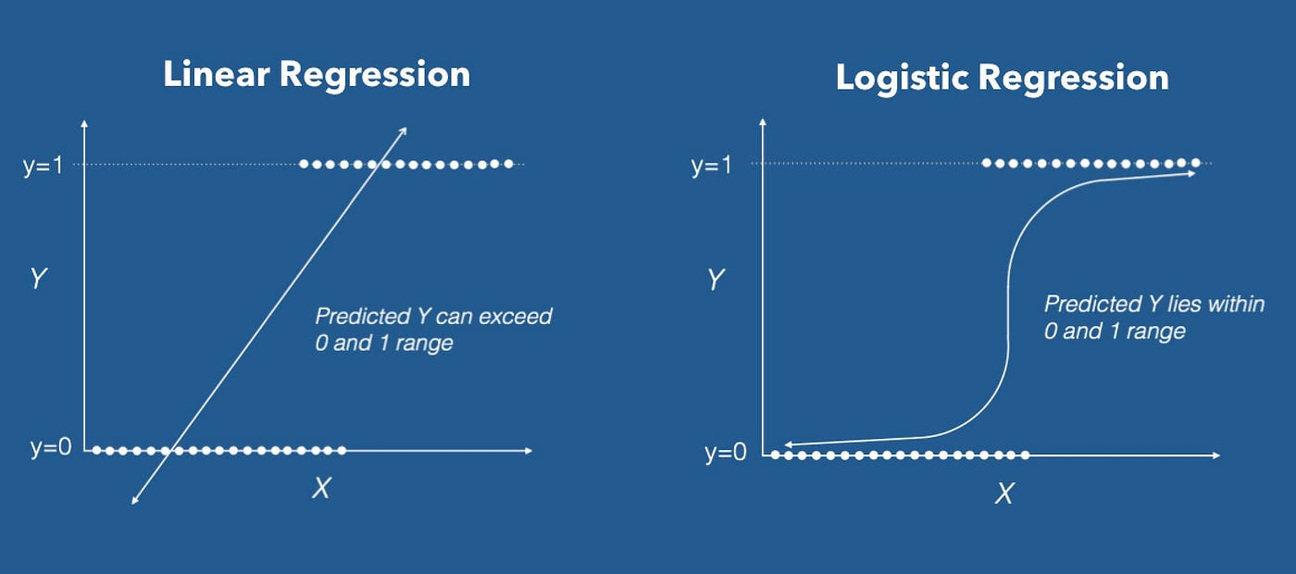
Logistic Regression

Slide 10

KNN
Step-1: Select the number K of the neighbors
Step-2: Calculate the Euclidean distance of K number of neighbors
Step-3: Take the K nearest neighbors as per the calculated Euclidean distance.
Step-4: Among these k neighbors, count the number of the data points in each category.
Step-5: Assign the new data points to that category for which the number of the neighbor is maximum.
Step-6: Our model is ready.

Slide 11
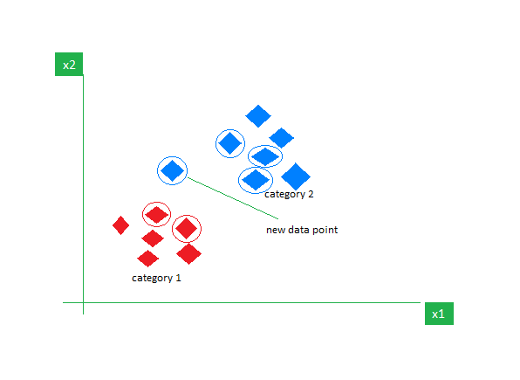

Slide 12

SVM
The main goal of SVM is to divide the datasets into classes to find a maximum marginal hyperplane (MMH) and it can be done in the following two steps −
First, SVM will generate hyperplanes iteratively that segregates the classes in best way.
Then, it will choose the hyperplane that separates the classes correctly.

Slide 13


Slide 14


Naïve Bayes
It is a probabilistic classifier, which means it predicts on the basis of the probability of an object.
Some popular examples of Naïve Bayes Algorithm are spam filtration, Sentimental analysis, and classifying articles
The formula for Bayes' theorem is given as:

Slide 15

Decision Tree
Step-1: Begin the tree with the root node, says S, which contains the complete dataset.
Step-2: Find the best attribute in the dataset using Attribute Selection Measure (ASM).
Step-3: Divide the S into subsets that contains possible values for the best attributes.
Step-4: Generate the decision tree node, which contains the best attribute.
Step-5: Recursively make new decision trees using the subsets of the dataset created in step -3. Continue this process until a stage is reached where you cannot further classify the nodes and called the final node as a leaf node.

Slide 16
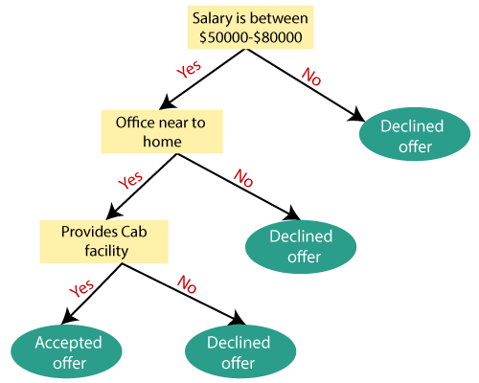

Slide 17
A Quick Look On The Dataset

Slide 18
Attribute Information:
age
sex
chest pain type (4 values)
resting blood pressure
serum cholestoral in mg/dl
fasting blood sugar > 120 mg/dl
resting electrocardiographic results (values 0,1,2)
maximum heart rate achieved
exercise induced angina
oldpeak = ST depression induced by exercise relative to rest
the slope of the peak exercise ST segment
number of major vessels (0-3) colored by flourosopy
thal: 0 = normal; 1 = fixed defect; 2 = reversable defect The names and social security numbers of the patients were recently removed from the database, replaced with dummy values.

Slide 19
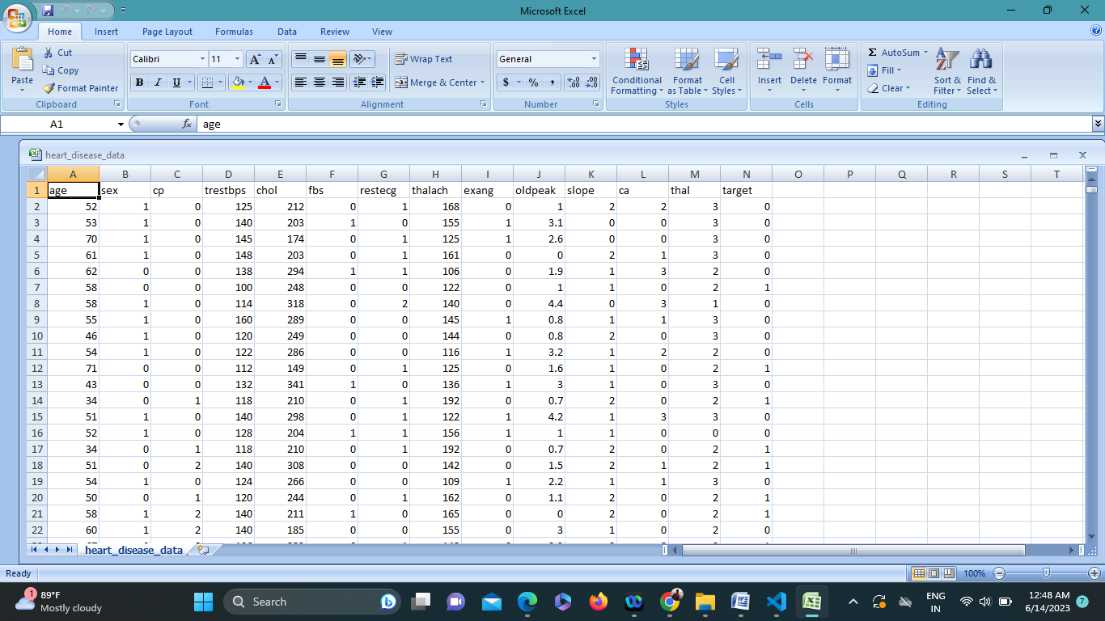
CSV File Screenshot

Slide 20
Some Coding Screenshots

Slide 21
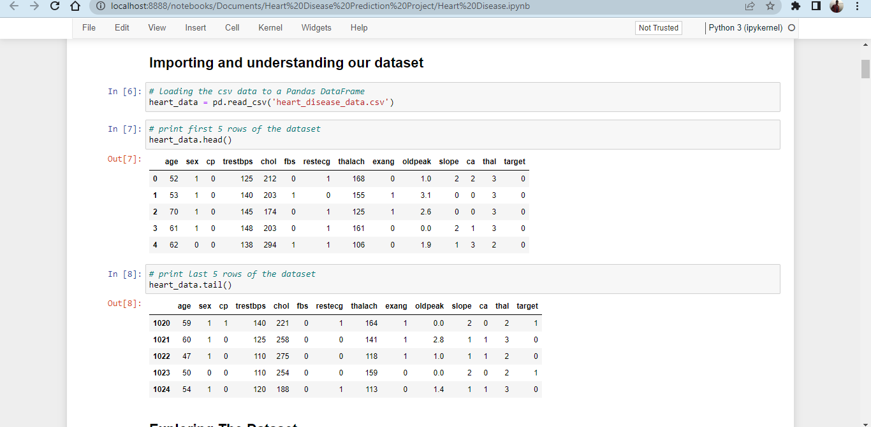

Slide 22
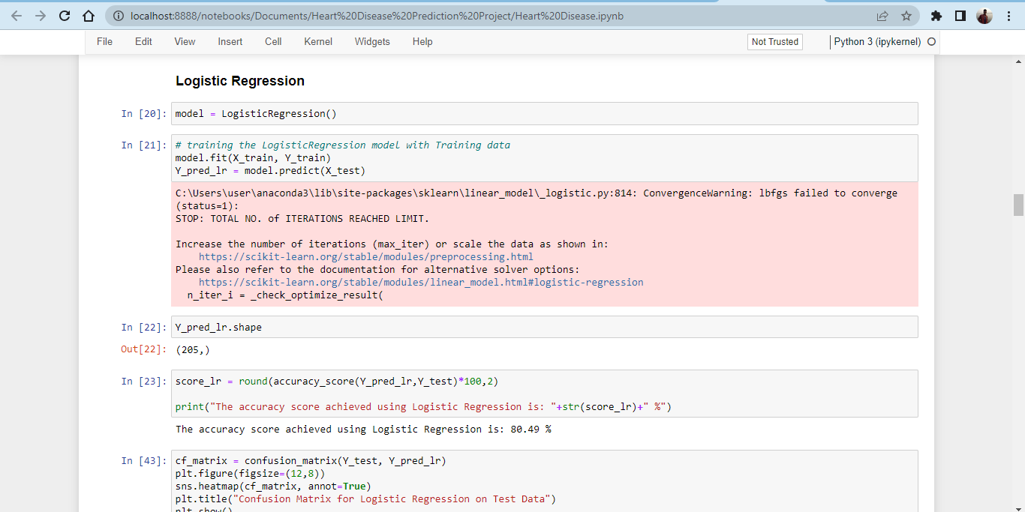

Slide 23
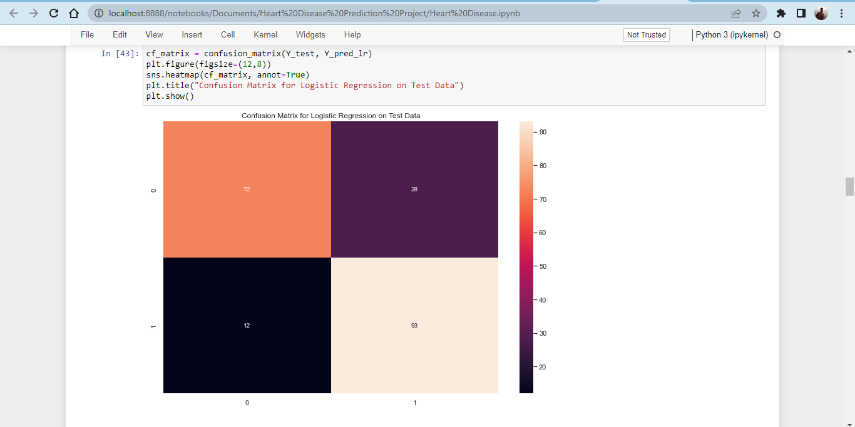

Slide 24
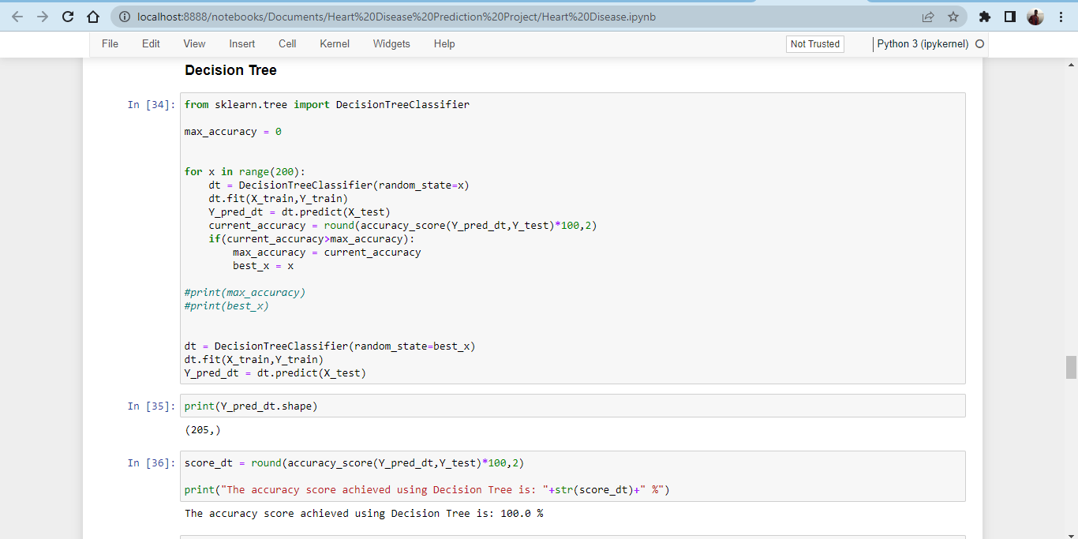

Slide 25
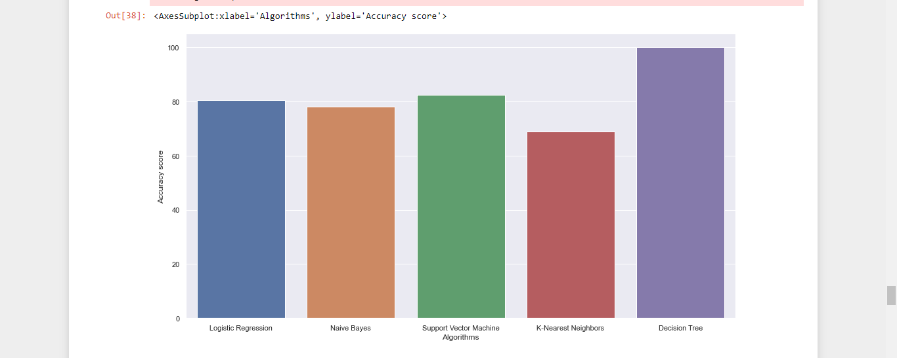
Comparison Of Algorithms

Slide 26
Now, the interface where User can give input and Predict Heart Disease

Slide 27
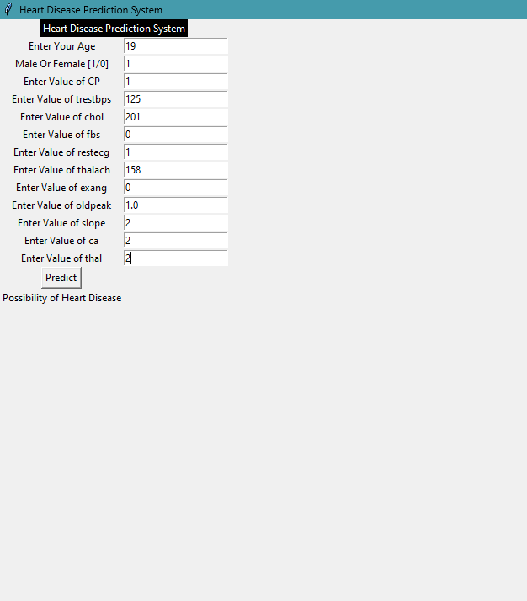
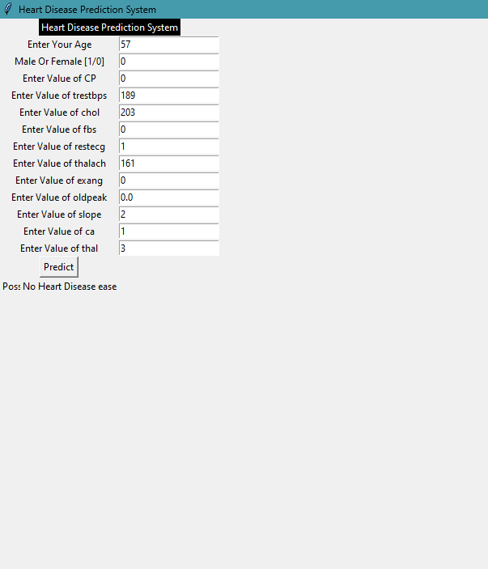

Slide 28
Future Work
We will try to improve the accuracy score of the models
To enhance the functionality of the prediction engine we will try to provide more data
We will work on the user interface to make it look more attractive

Slide 29
Thank You

